Slide 1
TITLE: AUTOMATED CLASSIFICATION OF GASTROINTESTINAL TRACT DISEASES USING HYBRID MODEL
Under the Guidance of Presented by – Batch 29
Mrs. D. Vijaya Sri 23761A1267 – A. Anuradha
Sr. Asst. professor 23761A12C8 – U. Pravallika
23761A1290 – J. Gopi Chandu

Slide 2
domain:
Artificial Intelligence (AI) – Deep Learning: Artificial Intelligence (AI) enables computers to perform tasks that normally require human intelligence. Deep Learning, a branch of AI, uses neural networks to automatically learn features from medical images and improve disease classification.

Slide 3
ABSTRACT:
Gastrointestinal diseases can cause serious health problems if they are not identified at the right time. In recent years, many deep learning methods have been developed to classify these diseases from endoscopic images, but most of them use a single type of model for feature extraction. As a result, some important image information may not be captured effectively. This project extends the existing work by combining a CNN-based model with a transformer-based model to make better use of the information present in endoscopic images. The proposed approach is expected to learn both detailed and overall image features, which can help improve disease classification.

Slide 4
EXISTING SYSTEM:
Uses a pre-trained DINOv2 model with a lightweight classifier.
Uses the Capsule Vision 2024 dataset with 50,000+ labeled capsule endoscopy images.
Classifies 10 gastrointestinal disease classes.
Relies on a single model and struggles with visually similar disease classes.

Slide 5
DRAWBACKS OF EXISTING SYSTEM:
Uses only a single DINOv2 architecture for feature extraction.
Local image details may not be captured effectively
Struggles to distinguish visually similar disease classes.
Limited feature representation due to a single-model approach.

Slide 6
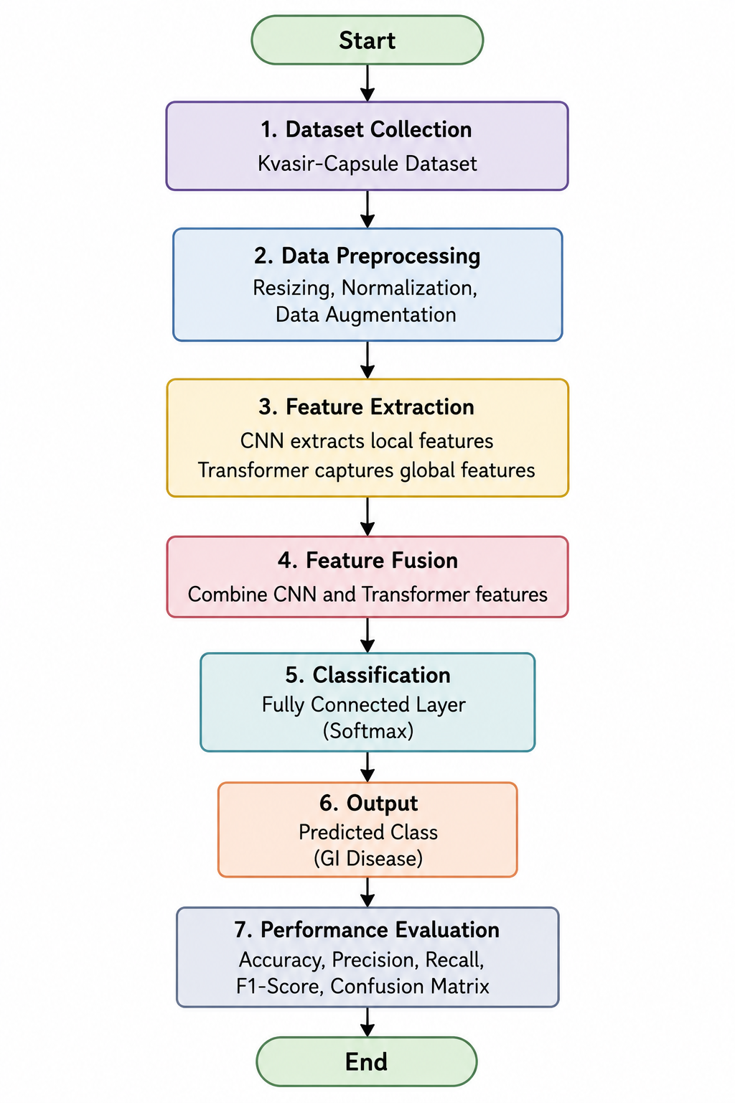
PRoPOSED SYSTEM:
Develops a hybrid CNN–Transformer model for gastrointestinal disease classification.
CNN extracts local features such as textures and lesion details.
Transformer captures global contextual information from the image.
Combines features from both models using feature fusion.(ConvNeXt+MaxViT)
Uses the Kvasir dataset for model training and evaluation. .

Slide 7
ADVANTAGES OF PRoPOSED SYSTEM:
Uses both CNN and Transformer instead of relying on a single DINOv2 model.
Captures local image features and global contextual information simultaneously.
Improves the classification of visually similar gastrointestinal diseases. Provides a richer feature representation through feature fusion.
Uses the Kvasir-Capsule dataset, which is publicly available and suitable for capsule endoscopy research

Slide 8
Literature survey
TITLE NAME | YEAR | AUTHOR | MODELS USED | KEY CONTRIBUTION | ACCURACY
Enhanced DINOv2-Based Framework for Multi-Class Gastrointestinal Abnormality Classification in Capsule Endoscopy | 2025 | Manav Anand, Pradneya Prabhudesai, Pranav Kumar, Geeta Sikka, and Arjun Singh Rawat | DINOv2 ViT-B/14 encoder, lightweight classifier head (dense layers with ReLU and Softmax), and Adam optimizer | It uses a frozen pre-trained Vision Transformer (DINOv2) with a lightweight classification head to highly accurately and efficiently categorize ten distinct gastrointestinal abnormalities from video capsule endoscopy images without the need for extensive fine-tuning | 93.31%
A Novel Random Forest-SMOTE Framework With Polynomial Feature Engineering for Early Detection of Gastrointestinal Disorders | 2025 | Parvez Rahi, Mohammad Rashid Hussain, Salem Alqahtani, Mohammad Husain, Ajay Pal Singh, and Inderjeet Singh | Random Forest (RF), Synthetic Minority Oversampling Techni-que(SMOTE), GridSearchCV, Polynomial Feature Engineer-ing, CNN, LightGBM, and TabNet | It introduces a highly accurate, non-invasive system that predicts gastrointestinal diseases based on a patient's tabular clinical, lifestyle, and genetic symptom data rather than relying on images | 96.61%

Slide 9
Literature survey
TITLE NAME | YEAR | AUTHOR | MODELS USED | KEY CONTRIBUTION | ACCURACY
Transfer Learning in Endoscopic Imaging: A Machine Vision Approach to GIT Disease Identification | 2024 | Jayavrinda Vrindavanam, Pradeep Kumar, Gaurav Kamath, and Abhilash S Bharadwaj | EfficientNetV2S, MobileNet-V3 Large, ResNet-50, DenseNet201, and a baseline Convolutional Neural Network (CNN) | It evaluates lightweight, pre-trained transfer learning architectures to identify eight GI diseases, proving that models like EfficientNetV2S can achieve high accuracy without being trained from scratch | 95%
Modified Salp Swarm Algorithm With Deep Learning Based Gastrointestinal Tract Disease Classification on Endoscopic Images | 2023 | Marwa Obayya, Fahd N. Al-Wesabi, Mashael Maashi, Abdullah Mohamed, Manar Ahmed Hamza, Suhanda Drar, Ishfaq Yaseen, and Mohamed Ibrahim Alsaid | Modified Salp Swarm Algorithm (MSSA), improved Capsule Network (CapsNet), Deep Belief Network with Extreme Learning Machine (DBN-ELM), and Backpropagation | It creates an automated pipeline that uses a self-tuning metaheuristic algorithm (MSSA) to optimize a capsule network for highly precise feature extraction and classification of GI tract diseases | 98.03%

Slide 10
CONCLUSION
The proposed hybrid CNN–Transformer model provides an effective approach for gastrointestinal disease classification using capsule endoscopy images. By combining local and global feature extraction, it overcomes the limitations of the existing single-model approach. The use of the Kvasir-Capsule dataset enables reliable model training and evaluation. This approach is expected to improve disease classification and support faster, more accurate clinical diagnosis.

Slide 11
Thank you..

